Slide 1
REAL TIME MONITORING OF COMA PATIENT’S USING OPENCV
P.Tarun Kumar 19BBTCS109
Ch.Madhu Babu 19BBTCS033
G.Karthikeya 19BBTCS043
A.V.Sai Tharun 19BBTCS023
Under the Guidance of
Dr. Kalyan N

Slide 2
CONTENTS
Abstract
Introduction
Problem Statement
Objective
Literature Survey
System Requirements
Proposed System
Advantages
Modules
Modules Description
System Architecture
Result and Screenshots
Conclusion
References

Slide 3
ABSTRACT
In this project, a health monitoring system for the coma patient based on the computer vision is implemented.
Computer vision as a new technology which facilitates the process of extracting, analyzing and sending data with high efficiency.
In this proposed system, four health parameters, lip movement, hand movement, leg movement and eye blinks are monitored.
By integrating these four parameters with live monitoring module and/or a SMS API module, the need for clinical staff and accompanying persons will be less as the systems allows relatives and staff to monitor the coma patient system or receive notification based on the patient’s status changes.

Slide 4
Introduction
Coma or unconsciousness is a medical state wherein the patient cannot respond to any internal or external stimulus.
The coma patient’s heart is still beating however he/she is unaware of his surrounding environment and has no physical control over his/her entire body.
Such continuous monitoring needs to measure the vital parameters at least for every 15 seconds until the patient’s condition becomes stable.
Monitoring of coma patients is different from monitoring the normal patients as it is very tough job for the paramedical staff to continuously monitor each patient’s 24 hours since the proportion of staff to patient is very low.

Slide 5
Problem Statement
The coma patient’s heart is still beating however he/she is unaware of his surrounding environment and has no physical control over his/her entire body.
Such cases require a serious attention and continuous monitoring to save the patient’s life.
Such continuous monitoring needs to measure the vital parameters at least for every 15 seconds until the patient’s condition becomes stable.
Thus, it is not an easy task to monitor each and every patient regularly.
Nowadays, having someone to watch critically ill person is very costly and needs experienced staff.

Slide 6
Objectives
The objectives of proposed system are given by:
• To monitor Coma patient.
• To detect the coma patient’s activity/movements.

Slide 7
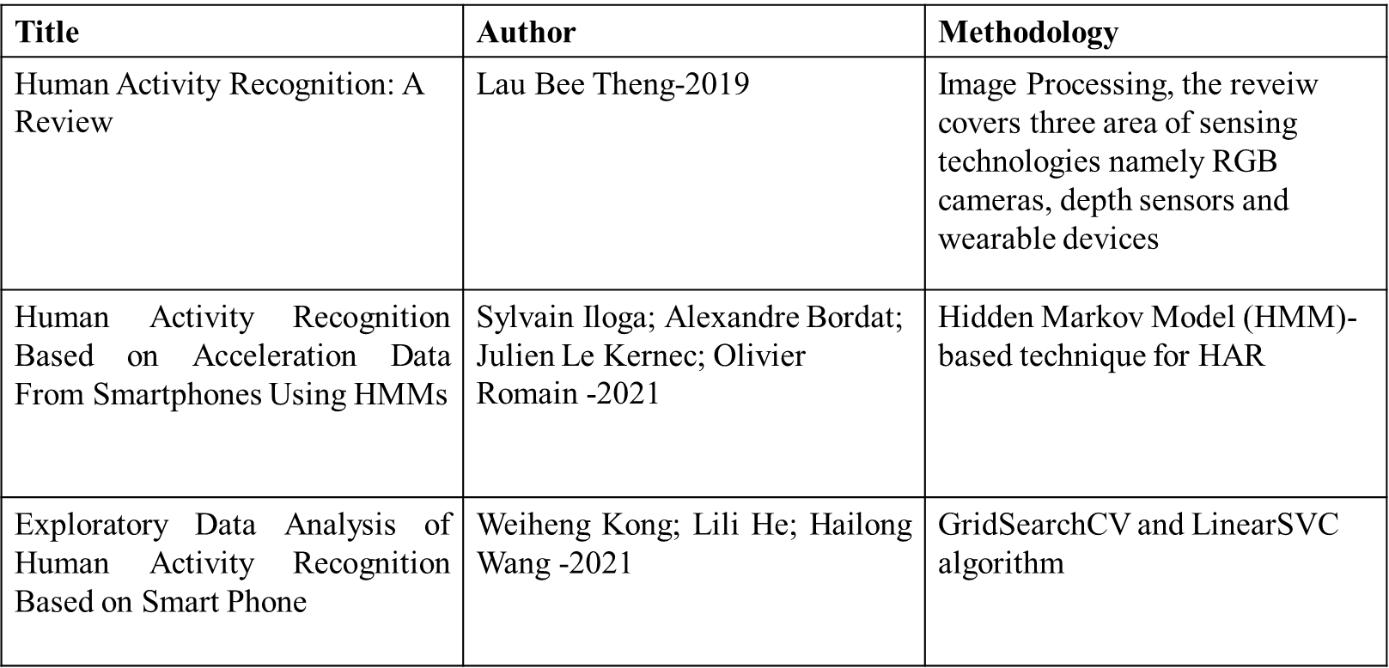
Literature Survey

Slide 8
System Requirements
Hardware Requirements :
Processors : More than inteli5
RAM : 8GB
Storage : 5GB
Standard Devices : Keyboard, monitor, mouse and camera

Slide 9
Proposed System
In this proposed system, four health parameters, lip movement, hand movement, leg movement and eye blinks are monitored .
System is implemented integrating these four parameters with live monitoring module and/or a SMS API module.

Slide 10
Advantages
The need for clinical staff and accompanying persons will be less as the systems allows relatives and staff to monitor the coma patient system or receive notification based on the patient’s status changes.

Slide 11
Modules
1.Capturing frame.
2. Pre-process and Extract Features.
3. Detection of movements like Lip Movement and Eye blink.
4. Alarm and message alert to doctor and family members.

Slide 12
Modules Description
1. Capturing frame:
This is the first module in our project we are initializing the camera in comma patient’s room and capturing the frames lively, In this module we are using OpenCV to capture the video in frame.
2. Preprocess and Extract Features:
In this module we read the frame by frame and resize into 700 width and converting into gray color then we are normalizing the frame using Gaussian blur algorithm to remove the noise in the frame. We are extracting the human face features from the frame using Haar cascade feature selection.
3. Detection of eye and mouth regions:
In this module we are passing human face extracted features as input our system will extract the features for eye and mouth using Haar Cascade feature selection and detect the area of eye and mouth in the frame.
4. Alarm and message alert to Doctor and Patient’s Guardian:
In this module if any movement is detected the alarm is rung and a message is sent alerting the doctor and the family member of the comma patient.

Slide 13
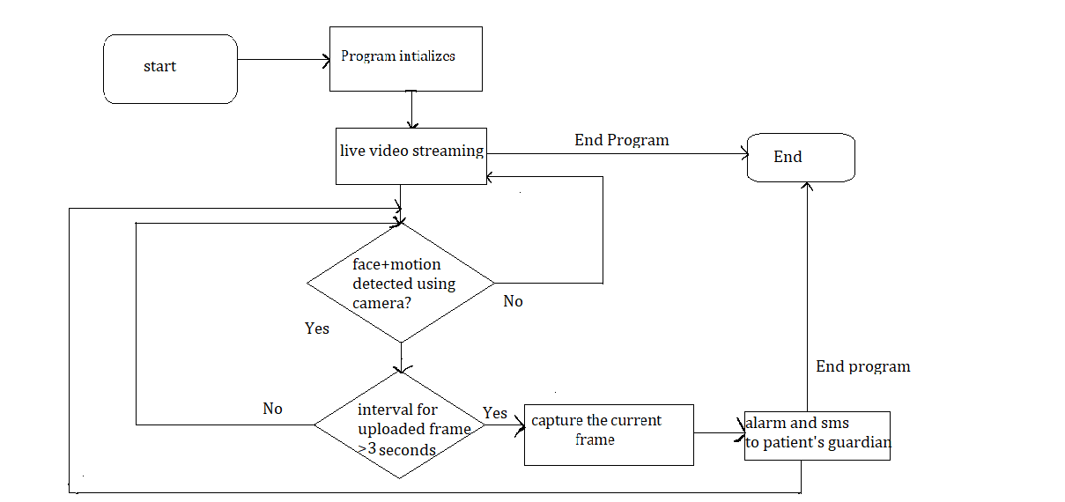
System Architecture

Slide 14
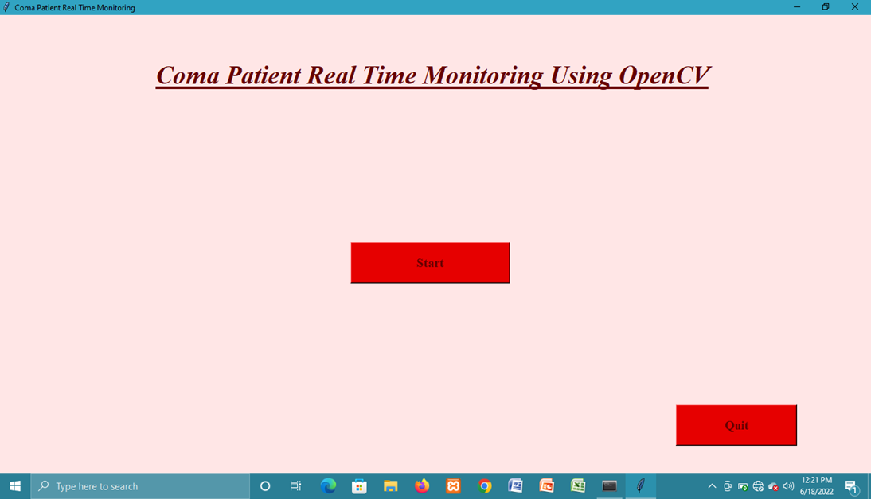
RESULTS & SCREENSHOTS
The fig 1.1, Represents the view of the Starting Graphical Interface Page

Slide 15
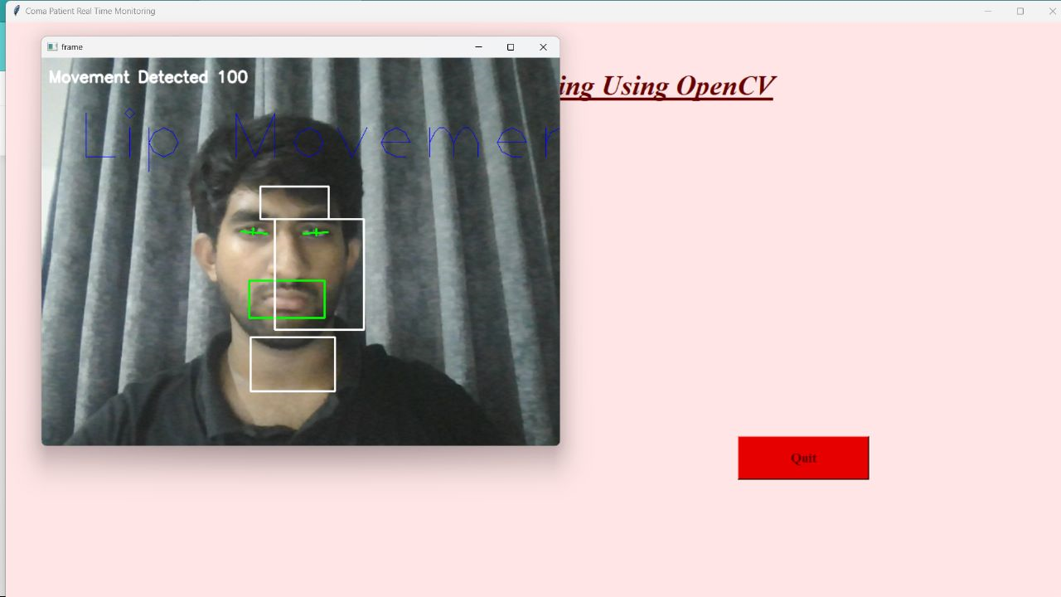
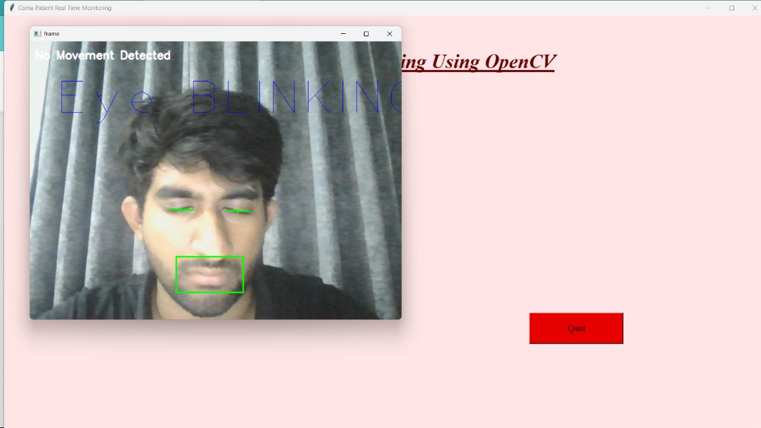
RESULTS & SCREENSHOTS
Lip Movement Detection
eye blinking detection

Slide 16
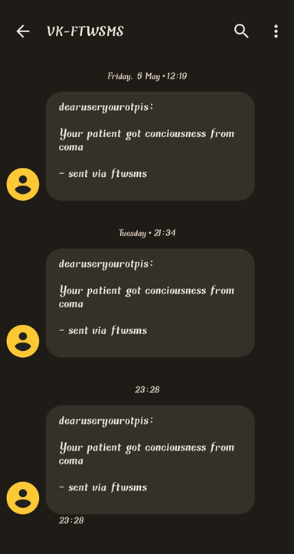
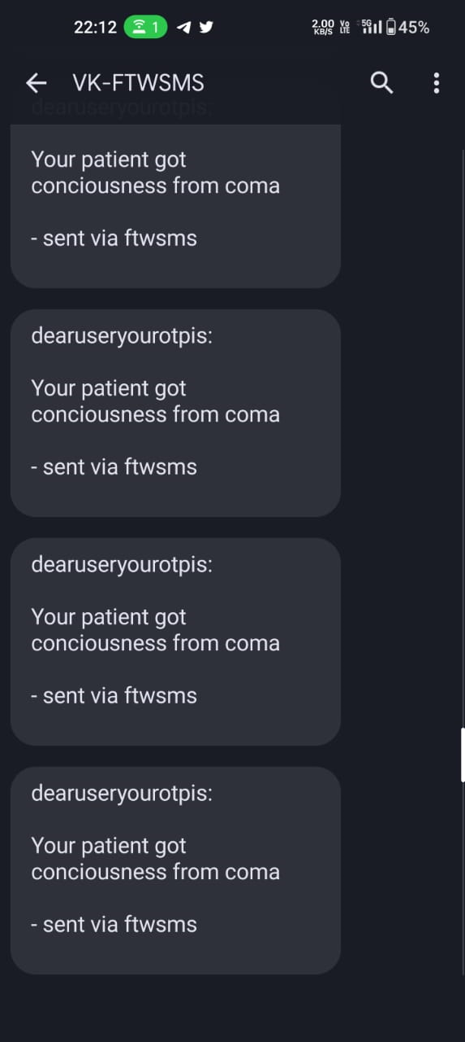
Fig 1.6: Message delivered to doctor and patient’s relative
The fig 1.6 shows the message log of the doctor and the patient’s relative

Slide 17
Conclusion
A system design for monitoring system is expected for comma patients. For monitor live we are using OpenCV. For remove the noise, we are using Gaussian Blur algorithm.
For extract features we are using Histogram of Oriented Gradients (HOG).
For detection the coma patient’s activity/movements we are using HAAR cascade Classifier.

Slide 18
References
[1] Munoz-Organero Mario (2018). Human Activity Recognition based on SingleSensor Square HV Acceleration Images and Convolution Neural Networks.
[2] Rong Liu, Ting Chen, Lu Huang (2020), Research on Human Activity RecognitionBased on Active Learning
[3] Lau Bee Theng (2019). Human Activity Recognition: A Review, on Image Processing.
[4] Ms.Shikha, Rohan Kumar, Shivam Aggarwal, Shrey Jain (2020). Human ActivityRecognition on CNN-RESNET-34.

Slide 19
THANK YOU!

